Slide 1
Setting up Python
This presentation will show you how to do the following:
Installing Python on Windows
Verifying the installation
Setting up the required Python extensions

Slide 2
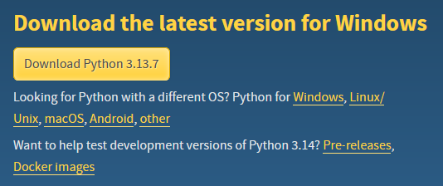
Setting up Python
Open this link and download the latest version of Python

Slide 3
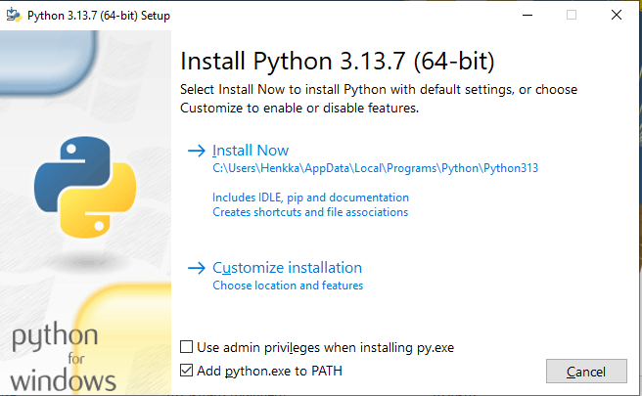
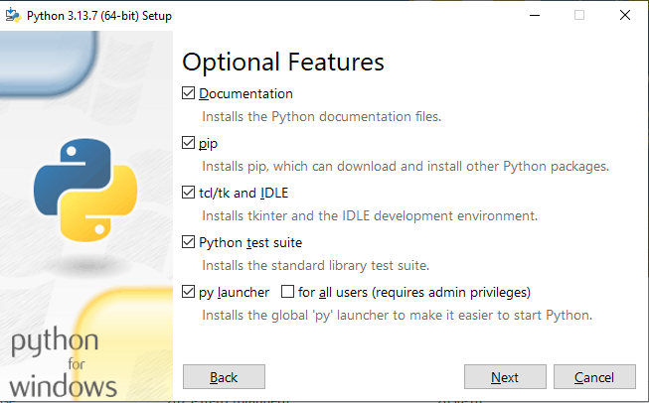
Setting up Python
Check the "Add python.exe to PATH" box
Chose Customize installation, this will open the Optional Features
In the optional Features check the following boxes according to the image, then press next

Slide 4
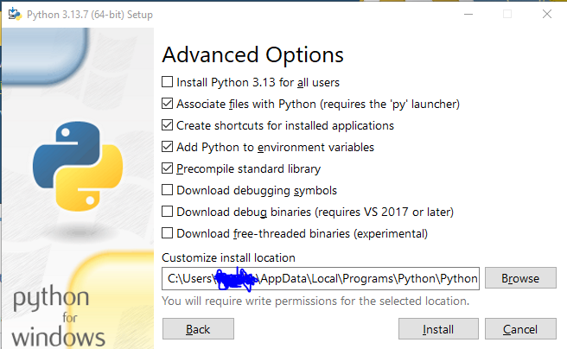
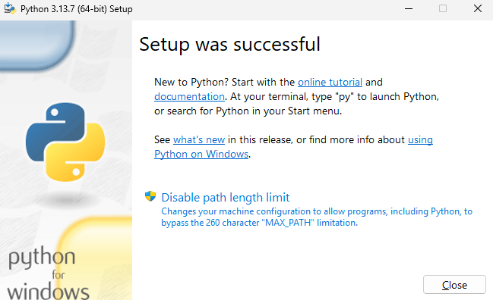
Setting up Python
In the "Advanced Options" check the following boxes according to the image
Choose the installation path or use the default path given, then press install
Once the Setup is successful press the "Disable path length limit" if the option to do so is present
Now check to see if the python installation was successful by opening the CMD and running the following command: "py -3 --version"
If the installation was successful the CMD will print the following line: "Python 3.13.7" (the version may differ)
Now that you have finalized the Python installation, you can close the setup & we'll get started with setting up the extensions in VScode next

Slide 5

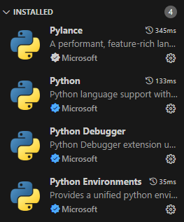
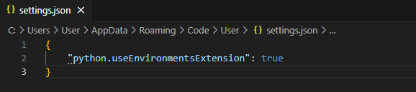
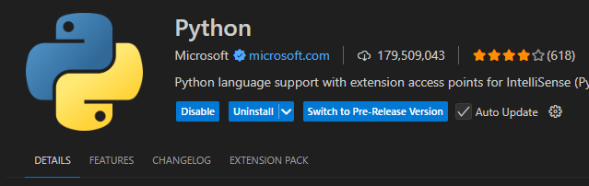
Setting up Python
Install the Python extension in VScode, this will automatically install the following 4 extensions, "Pylance, Python, Python Debugger, Python Environments"
Create a python file (test.py) this will enable the Python interpreter in the Status Bar (the bar on the bottom of VScode)
The activity bar (the bar on the left side of VScode) should have both Testing & Python icons, however if the Python icon does not appear then it needs to be enabled through the user settings in VScode
To enable the Python icon for the activity bar, Press CTRL + SHIFT + P and type Preferences: Open User Settings JSON , now add the following line of code
Save the Json file, then reload the window (CTRL + SHIFT + P , and type "Reload window")

